Slide 1

Introduction to DBMS

Slide 2
Topic of discussion
Difference between Data & Information
Definition of Database
DBMS
Application of DBMS

Slide 3
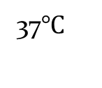
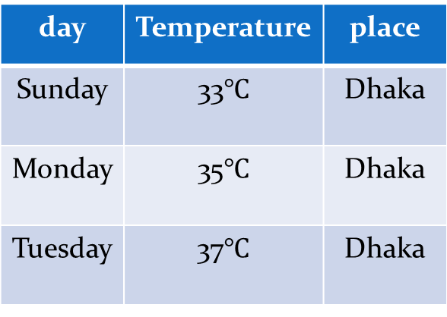
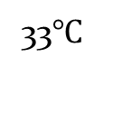
Data & Information
Data is raw, unorganized facts that need to be processed or recorded.
Ex: Text, number, image, video, audio, speech etc.
When data is processed, organized, structured or presented in a given context so as to make it useful, it is called information.
day | Temperature | place
Sunday | 33$℃$ | Dhaka
Monday | 35$℃$ | Dhaka
Tuesday | 37$℃$ | Dhaka
37$℃$
Dhaka
Monday
Sunday
33$℃$

Slide 4
Database
Database is collection of related data.
A collection of organized data.
Ex: YouTube , DIU website etc.
Some example of database
TDB (Traditional Database) store; text, number
MDB (Multimedia Database) store; audio, video, movie etc.
GIS (Geographic Information System)
Satellite etc. store; images
RDB (Real time Database)
Production use. Ex: inventory management system

Slide 5
Data warehouse
A data warehouse is a large collection of business data used to help an organization make decisions.
Large amount of historic data; ex: past hundred years

Slide 6
DBMS
A primary aim of the database system is to provide a convenient and efficient way to store and retrieve data stored in a database.
A database is a computer generated software program which can be used to access the data stored in database in an organized manner.
A software program which is used to store & manipulate the database

Slide 7
Database Applications
Sales
Accounting
Human resources
Banking and Finance
Airlines
Medicine Industry

Slide 8
Thank you

